Slide 1
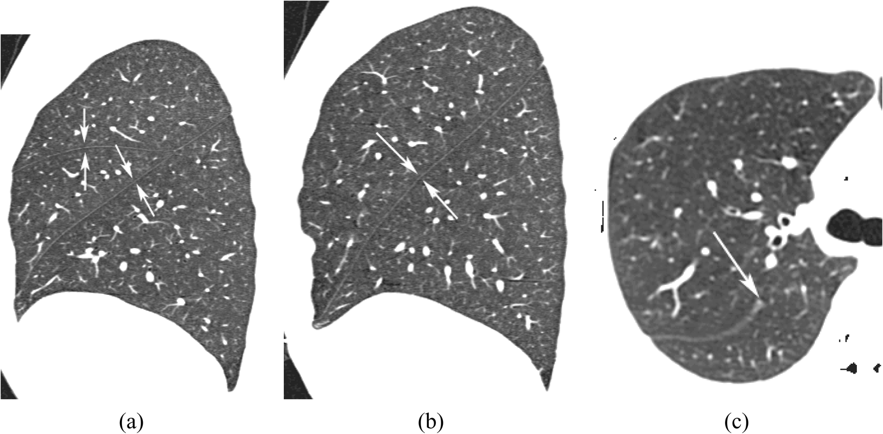
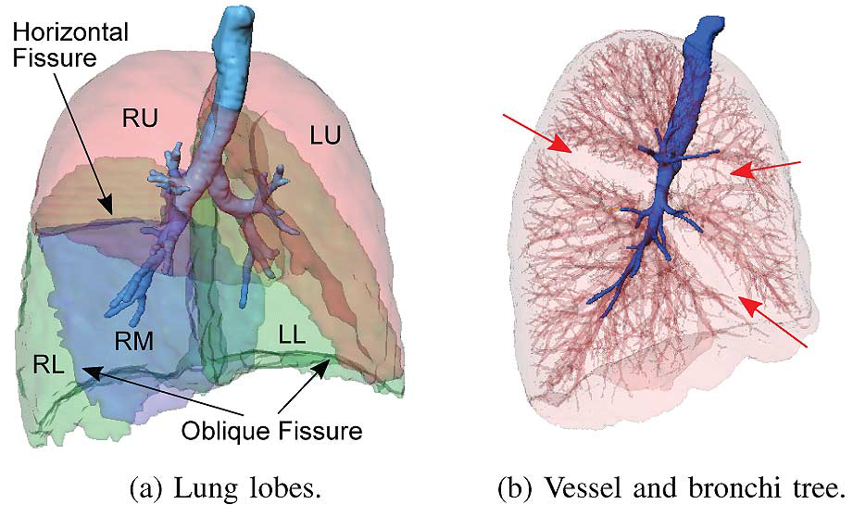
Addressing the challenges of lung lobe segmentation
Yuwen Zhang, Alys Clark, Habib Baluwala, Merryn Tawhai, Auckland Bioengineering Institute, The University of Auckland, New Zealand
Background
The human lung is divided into five distinct anatomic compartments called lobes. The separating junctions between the lobes are called the lobar fissures. The left lung consists of the upper and lower lobes, which are separated by the left oblique (major) fissure. The right lung consists of the upper, middle, and lower lobes, which are separated by the horizontal (minor) fissure and the right oblique (major) fissure (see Fig. 1) [1].
Some pulmonary diseases are more prevalent in specific anatomic regions of the lung. Thus, segmentation of the lobes and understanding the tissue and functional characteristics of the lobar parenchyma is clinically important for disease classification and may provide insights into the basic pathophysiology of lung disease.
Challenges of pulmonary lobe segmentation
Anatomical variation is associated with age, sex and body type [2]
Fuzzy appearance of fissures on CT images, in particular in the presence of abnormalities near the fissures, makes fissure segmentation challenging.
Even in patients with normal lung parenchyma the fissures are often not complete (examples are shown in Fig 2)[3].
CT
Training Data
Lobe Surface Sampling
New Input Image
Lobe Boundary Model Construction (PCA)
Lobe Boundary Refinement
Fissure Detection
(a) (b) (c)
Lobe Segmentation Result
Fig.2: (a) the right oblique and horizontal fissures (b) the left oblique fissure. (c) an incomplete right oblique fissure.
Fig.3: Overview of the method steps for fissure detection and lobe segmentation
Our proposed solution
To overcome these challenges, we plan to segment pulmonary lobes using a PCA-based model. An average lobe boundary model based on PCA through sampling lobe boundaries (including fissure surfaces) of a set of training data (about 40 subjects, all healthy divided into old and young groups) is currently being generated.
The use of PCA shape modeling provides a convenient way to identify target regions which are highly likely to represent fissure surfaces. With the help of the average model, we will be able to eliminate some non-fissure structures and capture variation of lung lobe shape across a population which will make the process of automatic lobe segmentation and fissure detection more efficient.
Within the region of likely fissure location predicted by the lobe boundary model (ROI), a standard algorithm for fissure detection (e.g. based on Hessian matrix or marching cubes algorithm, MCA) will be used to find the fissure location accurately. This will be tested using artificial input images. For cases with some incomplete fissures, the “smooth” interpolation and extrapolation by the use of implicit functions may be helpful to extend the fissure surfaces to the lobe boundary smoothly and naturally. A 3D optimal surface detection will be performed around the predicted region of the fissures to help refine the lobe boundaries.
Summary
The key aim of our work is to implement an interactive method that realises a fast and accurate segmentation and correction based on a given standard PCA model.
Incomplete fissure detection and the realisation of a timesaving algorithm will be the next step of this work.
A comparison between the new method and previous segmentation methods is necessary to verify its practicability and effectiveness.
References
[1] Lassen B.et al. IEEE TMI. 2013, 32(3), pp. 210-222
[2] Ross JC. et al. J. Med. Phys. 2013, 40(12), 121903
[3] Ukil S et al. 2009, IEEE T-MI,28(2),pp. 202-214
Fig.1: Renderings of the anatomy of the lungs. This shows the human lungs subdivided into the right upper (RU), right middle (RM), right lower (RL), left upper (LU), and left lower (LL) lobe.

